Slide 1
Holy Cross Catholic Primary School
Liturgy for Holy Week
2021

Slide 2
We start our Liturgy for Holy Week
by making the Sign of the Cross

Slide 3
Gathering Prayer
We gather today R. Be with us Lord
We gather to pray R. Be with us Lord
This is Holy Ground R. Be with us Lord
We light a light to remind us that Jesus is with us as we pray today
R. Be with us Lord

Slide 4
Let us pray.
Lord Jesus Christ, You did not come to be served, but to serve. Give us grace to lay aside all our selfishness, clothe us with your power, and crown us with your humility, that finally, in the glory of serving, we may stand beside your throne, where with the Father and the Holy Spirit you reign, one God, now and forever. Amen.

Slide 5
Sing: The Servant King

Slide 6
First Reading
Moses and all the people of God had to leave Egypt quickly.
The King of Egypt had only just said they could go, and they were afraid
he would change his mind again.
So they had a good meal before they began their long journey.
A Reading from the Book of Moses
Each family took a sheep or a goat and killed it.
Then they used its meat for the meal.
If any family was too small to eat a whole sheep,
they had to share it with another family.
The animal was roasted over a fire – it had to be well cooked,
and if anything was left over, it had to be burnt.
There was also unleavened bread to eat,
and sauce to go with the meat.
No one sat down for this meal,
they all ate standing up,
For everyone was in a hurry to escape from Egypt.
The Word of the Lord.
R: Thanks be to God

Slide 7
Gospel Reading
Each year, the Jews had a ‘Pass-over Meal’ when they ate the ‘Pass-over Lamb’, and remembered how they had escaped from Egypt long, long ago.
The Last Supper was a special meal like this.
The Reading comes from the Gospel of Saint Mark
The friends of Jesus came to him and said,
‘Where do you want to have the ‘Pass-over Meal’?’
So Jesus said, ‘Go to the city if Jerusalem and find the man with the water jug.
Follow him and he will take you to a house where you can get a room. Just tell the owner of the house what I want and he will show you a large dining room upstairs.
Everything will be ready there.
So they went into the city just as he told them to do and they found everything just as Jesus had said.

Slide 8
Gospel Reading
That evening, while Jesus was eating with ‘The Twelve’, he said
‘One of you is going to let me down even though he is sitting with me now!’
They were all very upset, and each of them asked,
‘Surely, Lord, you don’t mean me?’
But he said,
‘Yes, it is one of you, and even now he is still eating with me from the same dish!’
Then he took some bread, he said a prayer of blessing, he broke the bread into pieces, and gave it to them all.
‘Take this,’ he said.
‘This is my body.’
Then he took the cup of wine, and he said a prayer of thanks. He passed the cup round to them and they each drank from it.
‘This is my life-blood,’ he said,
‘Which will be poured out for you.’
The Gospel of the Lord: Praise to you Lord Jesus Christ

Slide 9
Fr Jonathan

Slide 10
Sing: At the Cross

Slide 11
Let us pray
We bring all our needs to God, Our Father, who loves us and listens to us when we pray.

Slide 12
Intercessions
We thank Jesus for being our Servant King. We pray that Jesus will help us to continue the good work that we have started during Lent, and follow the example that he has set us.
Lord hear us.
R: Lord graciously hear us

Slide 13
Intercessions
We thank God for His great love.
For giving us his son Jesus Christ, who died for us so that we could have eternal life.
Lord hear us.
R: Lord graciously hear us

Slide 14
Intercessions
We pray for those who are ill, or facing difficulties: may they find hope in the cross of Christ, and be strengthened by the knowledge of God’s love.
Lord hear us.
R: Lord graciously hear us

Slide 15
Intercessions
We thank God for the new life we celebrate at Easter.
We ask Him to help us to keep growing closer to Him.
Lord hear us.
R: Lord graciously hear us

Slide 16
Intercessions
We pray for Pope Francis, Bishop Philip and Father Jonathan.
May God bless them and help them to serve His people.
Lord hear us.
R: Lord graciously hear us

Slide 17
Intercessions
We pray for the ‘Peace of Christ’, in our homes, in our school and around the world this Easter
Lord hear us.
R: Lord graciously hear us

Slide 18
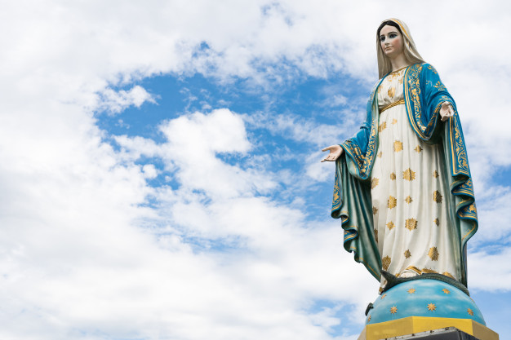
We join our prayers with all the Saints and Angels in heaven as we say…
Hail Mary
Full of Grace
The Lord is with thee
Blessed art thou among women
And blessed is the fruit of thy womb, Jesus.
Holy Mary
Mother of God
Pray for us sinners,
Now and at the hour of our death
Amen

Slide 19
Blessing
Sing: Easter Story

