Slide 1
Holy Cross Catholic Primary School
Liturgy for Pentecost
2021

Slide 2
We start our Liturgy for Pentecost
by making the
Sign of the Cross

Slide 3
Gathering Prayer
We gather today R. Be with us Lord
We gather to pray R. Be with us Lord
This is Holy Ground R. Be with us Lord
We light a light to remind us that Jesus is with us as we pray today
R. Be with us Lord

Slide 4
Let us pray
Almighty and ever-living God, you fulfilled the Easter promise by sending us your Holy Spirit. May that Spirit unite the races and nations on earth to proclaim your glory. Grant this through our Lord Jesus Christ, your Son who lives and reigns with you and the Holy Spirit, one God, for ever and ever.
Amen.

Slide 5
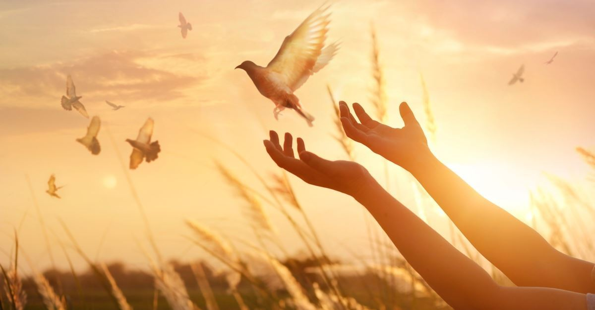
Sing: Risen! Risen!

Slide 6
First Reading
A reading from the Acts of the Apostles 2: 1-11
They were filled with the Holy Spirit, and began to speak different languages.
When Pentecost day came, the disciples had all met in one room to pray together, when suddenly they heard the sound of a powerful wind from heaven, which roared through the house. Then, what looked like small tongues of fire appeared and spread out to touch them, coming to rest on the head of each one of them. So it was that they were filled with the Holy Spirit.

Slide 7
At once, in their excitement, they rushed outside to tell everyone what had happened to them. As they began to speak, they were amazed to find that they could talk in foreign languages that they had never spoken before as the Spirit gave them the gift of speech. People from lands far and wide gathered in a crowd to listen to these men from Galilee. They were amazed, and came to believe in Jesus.

Slide 8
So it was, from that day onwards, the disciples travelled around telling everyone about Jesus, and sharing all that he had taught them. They were no longer afraid, for wherever they went, Jesus went with them.
Now his Spirit lived inside them, and they would never feel alone again.
The Word of the Lord
R: Thanks be to God

Slide 9
Gospel Acclamation
Alleluia, alleluia!
Come, Holy Spirit,
fill the hearts of your faithful
and kindle in them the fire of your love.
Alleluia!

Slide 10
Gospel Reading
The Reading comes from the Gospel according to John 20: 19 – 23
As the Father sent me, so I send you: Receive the Holy Spirit.
¹⁹ On the evening of that first day of the week, when the disciples were together, with the doors locked for fear of the Jewish leaders, Jesus came and stood among them and said, “Peace be with you!” ²⁰ After he said this, he showed them his hands and side. The disciples were overjoyed when they saw the Lord.
²¹ Again Jesus said, “Peace be with you! As the Father has sent me, I am sending you.” ²² And with that he breathed on them and said, “Receive the Holy Spirit. ²³ If you forgive anyone’s sins, their sins are forgiven; if you do not forgive them, they are not forgiven.”
The Gospel of the Lord R: Praise to you Lord Jesus Christ

Slide 11
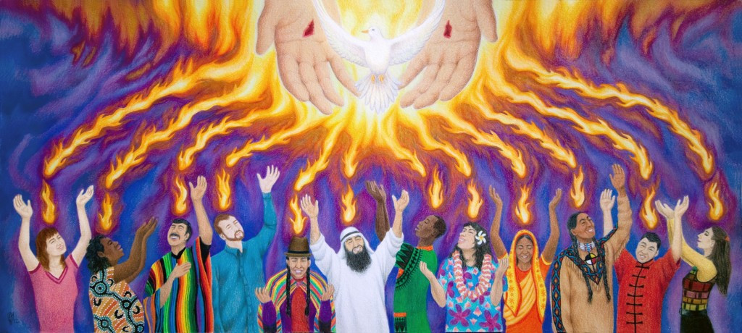
Fr Jonathan

Slide 12
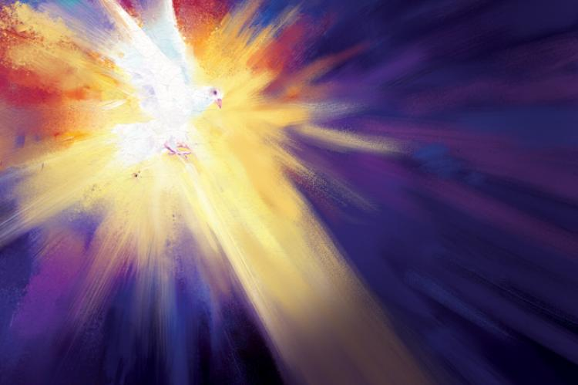
Sing: Here I am Lord
(I the Lord of Sea and Sky)

Slide 13
Let us pray
We bring all our needs to God, Our Father, who loves us and listens to us when we pray.

Slide 14
Intercessions
We pray for all God’s people;
That through Baptism the Holy Spirit will help us to act and think like children of God.
Lord hear us.
R: Lord graciously hear us

Slide 15
Intercessions
We pray for the sick and all who suffer. We pray that our Lord Jesus’ presence and peace be with them and their families.
Lord hear us.
R: Lord graciously hear us

Slide 16
Intercessions
We pray for all those who have died; that they will rise to the new and everlasting life promised through their baptism in Christ.
Lord hear us.
R: Lord graciously hear us

Slide 17
Intercessions
We pray for Pope Francis, Bishop Philip and
Father Jonathan.
May God bless them and help them to serve His people.
Lord hear us.
R: Lord graciously hear us

Slide 18
Intercessions
We pray for our school family gathered here today; that God will pour out his Spirit to strengthen us.
Lord hear us.
R: Lord graciously hear us

Slide 19
We join our prayers with all the Saints and Angels in heaven as we say…
Hail Mary
Full of Grace
The Lord is with thee
Blessed art thou among women
And blessed is the fruit of
thy womb, Jesus.
Holy Mary
Mother of God
Pray for us sinners,
Now and at the hour of our death
Amen

Slide 20
Come, Holy Spirit,
And fill our hearts with your love.
Come and fill us with your power, so that we may live in a way that pleases you.
Work through us to bring Jesus to those who do not know him,
So that we may share his love with others.
Grant this through Jesus Christ our Lord,
Amen.

Slide 21
Blessing
Sing: Shine Jesus Shine

